Slide 1
Profiling Data for Repurposing - Identifying Issues of Structure, Quality, Metadata & Provenance
Aaron Schroeder, Ph.D.
Associate Research Professor
Social & Decision Analytics Division
Biocomplexity Institute, University of Virginia
Notes:
Welcome to
About an hour, maybe a little more
Not a coding session
Conceptual understanding of what is expected when you are Profiling the datasets that have been selected for your projects
pseudo-code is sometimes provided - apply in your language of choice!
Having said that, most will be in R, and you'll be learning how to manipulate datasets to achieve these ideas in coming training sessions
Slides will be available on both Teams and the Training repo.
While it is not an interactive coding session, I have used flashy colors and sometimes things that move to keep your attention!
Also, please don't hesitate to ask questions along the way.
So, why is Repurposing highlighted?

Slide 2
Data Repurposing - Locating the Discussion
Secure/Privacy-Protecting Linkage
Distortion/Perturbation, Synthetic,
PUMS, SCIF
HIPPA
DFARS
HIPPA
FERPA
Dataset
Dataset
Dataset
Dataset
IDS
FISMA
State Law
Dataset
Dataset
Data Repurposing
Determining Data Fitness
?
Specific Question
DATA GOVERNANCE

Slide 3
Data Profiling: Issues of Structure - Time to Wrangle!
Combined Variables
Multiple Observation Directions
Combined Observational Unit Types
Divided Observation Unit Type
Missing Variables

Slide 4
Data Profiling: Issues of Structure - Combined Variables
more than one variable represented in an attribute (column) value
e.g. birth year, month, and day combined
Birthdate
YYYY/MM/DD
Birth Year
Birth Day
YYYY
Birth Month
DD
MM
Notes:
Combined variables refers to the condition where more than one variable is represented in a record field. Sometimes we end up with column variable names being comprised of a combination of multiple underlying variable names. It should be noted that many times this is an issue of problem definition, not necessarily bad design.
A common example with administrative record files occurs when we use parts of the date of birth field. For example, in the education case study, there was a need to categorize students by birth "year". To achieve this categorization, it was first necessary to divide out from the date of birth field the variables birth month, birth day, and birth year. While this is often achieved within the programming of a query (i.e. select datepart(‘year’, dateofbirth), what in fact is occurring is the separation of previously combined variables.

Slide 5
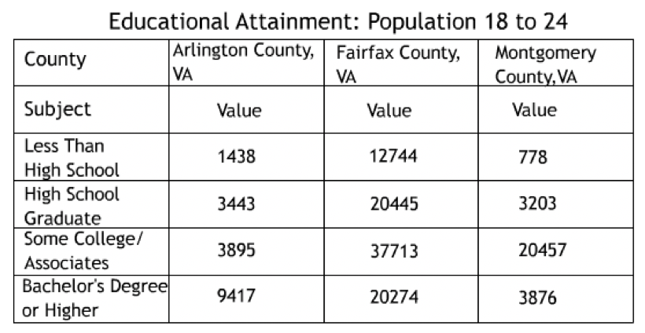
Data Profiling: Issues of Structure - Multiple Observation Directions
Variables in both Columns & Rows
Notes:
A particularly messy structural issue occurs when a dataset has variable names in both columns and rows. For example, a dataset with a field/column for each day of the month (on the horizontal) and a row title for ‘month’ (on the vertical).
This situation occurs most often when the data provided comes in the form of and cross-tabulated aggregate data.
For example, here we have a cross-tabulation of Educational Attainment.

Slide 6
Data Profiling: Issues of Structure - Combined Observation Unit Types
More than one observation unit type per table
e.g. A table containing both individual demographic data and a periodic measurement like weekly attendance where demographic data and weekly attendance are separate observational units and need to be in separate datasets.
Current Structure of Williamsburg MLS Data
List Number |  | Agency Name | Agency Phone | Agency Email | Listing Agent | Listing Agent Phone | Listing Agent Email | Co-Listing Agent | Property Type | Card Format
 | Book Section | Selling Agency | Selling Agency Phone | Selling Agency Email | Selling Agent | Selling Agent Phone | Selling Agent Email | Co-Selling Agent | End Date | book_sec
 | Listing Date | Sold Date | Under Cont. Date | Fall-thru Date | Status | Status Change | Withdraw Date | Cancel Date | Contingent | Cont. Remarks
 | Orig. List Price | Price | Sold Price | high_price | Low Price | assessed_val | Partial Tax Assmnt | financing | Area | Relocation
 | St. # | box_nbr | St. Dir. | Street Name | Address 2 | streetdirsuffix | Street Suffix | carrier_route | City | State
 | county | country | Zip Code | geo_county | Taxes | geo_lat | geo_lon | Est. Fin. SqFt | sqft1 | sqft2
 | sqft3 | sqft4 | Year Built | 2+ Bdroms on 1st Flr | Realtor.com Type | lot_size | Total Acres | Condo Level | sell_broker_comm | Variable Commission
 | stories | Total Rooms | Total Bedrooms | total_bath | Baths - Full | Baths - Half | baths_3_4 | Garage Type | garage_stall | Water Frontage
 | Zoning | taxes | Tax Year | Subdivision | Public Remarks | Agent Remarks | Parcel ID | Legal Description | Directions | Foreclosure
 | Owner Phone | Owner Name | Neighborhood | mod_timestamp | Ltd Service Agent | Occupied By | Owner/Agent | Mster Bdrm 1st Floor | SqFt Source | Listing Type
 | # Stories | # Fireplaces | Golf Frontage | IDX Y/N | Supplement Attached | Seller Concession(s) | Special Assmnts | Type | Rollback Taxes | userdefined16
 | SellingBroker Incent | Ownership | Describe Concession | How Sold | Selling Broker Comp | userdefined22 | Assessed Value | Est.Unfinished Sq Ft | Tax Rate | Garage Bays
 | userdefined27 | userdefined28 | userdefined29 | userdefined30 | Est. Closing Date | userdefined32 | userdefined33 | Lot Description | Short/CompromiseSale | userdefined36
 | userdefined37 | userdefined38 | userdefined39 | userdefined40 | userdefined41 | userdefined42 | userdefined43 | userdefined44 | userdefined45 | userdefined46
 | userdefined47 | userdefined48 | userdefined49 | userdefined50 | userdefined51 | userdefined52 | userdefined53 | userdefined54 | userdefined55 | userdefined56
 | Photo URL | Days on Market | Rooms | Features
Notes:
Combined Observation Unit Types
Within administrative records, multiple types of data are often combined for expediency.
By multiple types I mean different sets of data fields, each set representing a different type of observational unit (e.g. property information and listing agent information in the same record). The observational unit types necessary to the project at hand need to be separated out into individual observations or individual datasets in the restructuring phase.
An example from a housing case study is given here. The MLS dataset provided was comprised of single records with 128 fields. What you are seeing is a single record, not a table of data!
Each original record was identified by a unique "List Number". However, if a parcel was listed twice it would have two different "List Numbers." As a result, changes in a property or parcel over time could not be tracked from these records because the structure is organized by the list number, not the parcel number.
Changing the structure to include the "Parcel ID" allowed the required historical tracking of changes.

Slide 7
Data Profiling: Issues of Structure - Combined Observation Unit Types
Ideal Restructuring of MLS Data
Property Characteristics
∞
Property ID
&
Location
Property Sales Information
1
∞
Property Tax Information
∞

Slide 8
Data Profiling: Issues of Structure - Divided Observation Unit Type
observation unit type is split among multiple tables
e.g. Individual demographic information split among several datasets; for example, separate tables for gender, ethnicity, and surname.
gender1 id gender2
F 43XXX13 M
F 43XXX14 M
M 76XXX46 F
F 74XXX98 M
F 76XXX23 M
F 77XXX40 M
M 74XXX98 F
M 78XXX73 F
F 78XXX74 M
M 77XXX84 F
F 79XXX87 M
M 71XXX95 F
M 21XXX96 F
M 71XXX54 F
F 71XXX55 M
F 77XXX86 M
F 80XXX24 M
M 76XXX79 F
NC Student Data
Demographics Recorded in Multiple Tables
Actual 2011 data from different tables linked via unique ID
Many more tables with apparently separately collected demographics
Derivation of Demographic Truth is now Probabilistic
Notes:
Divided Observation Unit Type
Within administrative data systems, it is also not uncommon to find that a single observation unit type has been split among multiple data sets.
In fact, I would go so far as to say in certain types of agencies, like local social services, it's almost the norm.
This is the conceptual opposite of combined observational units.
For example, there may be, as was the case with one state’s educational records, separate tables that duplicate the collection of student demographics. What we see here is gender mismatches across two different datasets from the same education record information system, linked on the Unique Id of the student.
Decisions on whether and how to transform inconsistent data as a result of divided observation unit type need to factor in the 'magnitude' of the issue as well as the ability to accurately correct the data in a 'timely' enough fashion given the project at hand.
A primary decision factor on whether or not to correct is if there is systematic bias enough to sway the analysis results.

Slide 9
Data Profiling: Issues of Structure - Divided Observation Unit Type
observation unit type is split among multiple tables
e.g. Individual demographic information split among several datasets; for example, separate tables for gender, ethnicity, and surname.
NC Student Data
Demographics Recorded in Multiple Tables
Actual 2011 data from different tables linked via unique ID
Many more tables with apparently separately collected demographics
Derivation of Demographic Truth is now Probabilistic

Slide 10
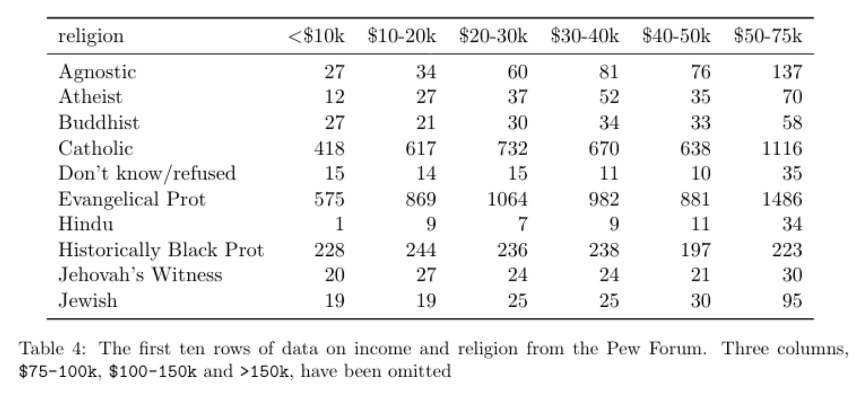
Data Profiling: Issues of Structure - Missing Variables
values in column headers instead of variable names
e.g. Value-ranges being used as column headers (0-9|10-19|20-29|…)
More rare, but they are out there!
Notes:
‘Missing variables’ means that a dataset has values in column headers instead of variable names. It is not uncommon to receive tabular datasets that have been designed for the purpose of presentation, not analysis, where variables form both the rows and columns, and column headers are values, not variable names. Such files are often initially produced for the purpose of conveying aggregated summary data to decision-makers and are not constructed like a traditional dataset (i.e. one record per row with clear field/column titles).

Slide 11
Data Profiling: Issues of Quality
Data Quality
Typology of Quality ‘Rule-Types’ (Psuedo-code)
Null Constraints | select sqft from housing where sqft = 0 or sqft = '' or sqrt = NULL
Domain Validation | select yearbuilt from housing where yearbuilt is between 1920 and 2015
Relationship Validation | select all from housing where type = multifamily and numunits greater than 1
Notes:
Regardless the quality typology chosen, the final judgment of data quality is measured by adherence of a dataset to a set of data quality rules.
Like data quality attributes, these rules can take one of several forms. Here we choose a typology consisting of three rule-types employed by the DoD in its data quality management efforts. These are: null constraint rules, domain validation rules, and relationship validation rules. Code is developed to enforce these rules. Examples here are given in psuedo-code.

Slide 12
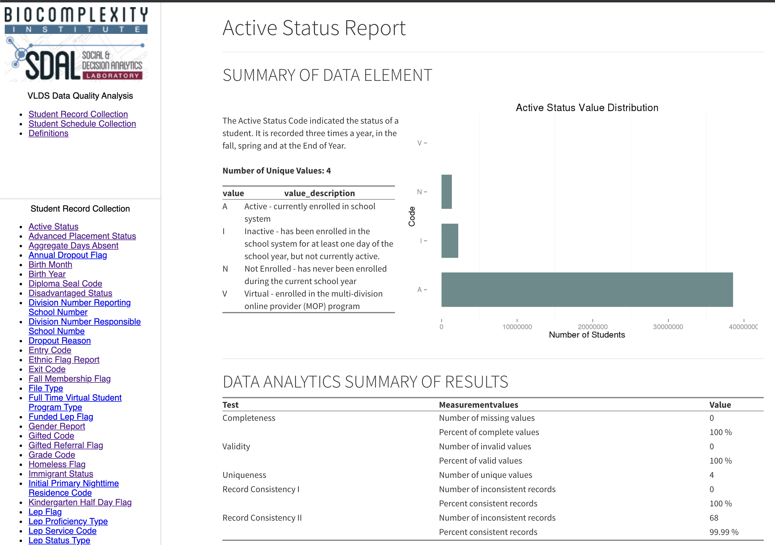
Data Profiling: Issues of Quality
Completeness
Value validity
Record Consistency
Longitudinal Consistency
Uniqueness
Duplication
Example: VDOE Data Quality Analysis
Notes:
A considerable amount of data quality research involves investigating and describing various categories of desirable attributes (or dimensions) of data. These lists commonly include accuracy, correctness, currency, completeness and relevance, as described in Chapter 2. Nearly 200 such terms have been identified and there is little agreement in their nature (are these concepts, goals or criteria?), their definitions or measures (Wang et al., 1993).
For our purposes we have let a typology emerge form the project data work.
This typology consists of six data quality areas:
completeness,
value validity,
record consistency,
longitudinal consistency,
uniqueness,
and duplication.

Slide 13
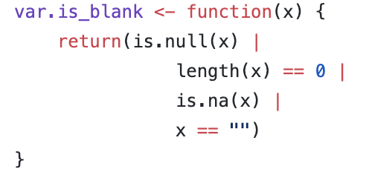
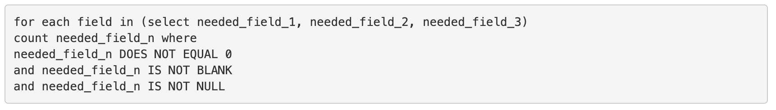
Data Profiling: Issues of Quality - Completeness
percentage of elements properly populated
e.g. Testing for NULLs and empty strings where not appropriate
In R
Notes:
The concept of data completeness can be generalized as the proportion of data provided versus the proportion of data REQUIRED.
Data that is missing may additionally be categorized as
record fields/columns not containing data,
records not containing necessary fields/columns,
or datasets not containing the requisite records.
The most common conceptualization of completeness is the first, record field/column not containing data.
This conceptualization of data completeness can be thought of as the proportion of the data that has values to the proportion of data that ’should’ have values. That is, a set of data is complete with respect to a 'given purpose' if the set contains all the relevant data for that purpose. Completeness is application specific. It would be incorrect to simply measure the number of missing field values in a record without first considering which of the fields are actually necessary for completion of the task at hand.
For example, in our study of Multiple Listing Service Real Estate (MLS) data, a dataset was provided with each record containing 128 fields. Per record, many of these fields are missing data, however, most of these fields were not important to the purpose of the study (e.g. Listing Agent, Owner Name, Owner Phone). It would not be helpful to categorize the proportion of missing values for these fields. Instead, a decision must first be made as to which fields belong in the analysis for the current purpose. An example pseudo-code would look something like:
In most languages, unless a specific function has already been written for it, you'll need to check for all of these! For example, in R:

Slide 14
Data Profiling: Issues of Quality - “Value” Validity
percentage of elements whose attributes possess meaningful values
to ascertain how many entries contain non-valid values for a non-empty text field representing gender, an example pseudo-code domain comparison-constraint rule would look something like:
count gender where gender is not in (male, female, no answer)
a pseudo-code domain interval-constraint rule would look something like
count age where age is not between [0,110]
Notes:
The concept of value validity can be conceptualized as the percentage of elements whose attributes possess expected values. The actualization of this concept generally comes in the form of straight-forward 'domain constraint rules'.
For example, to ascertain how many entries contain non-valid values for a non-empty text column representing 'gender', an example pseudo-code domain comparison-constraint rule would look something like:
count gender where gender is not in (male, female) Or, to ascertain how many entries contain non-valid values for a non-empty integer field representing age, a pseudo-code domain interval-constraint rule would look something like:
It should be noted that in many discussions of data quality, this concept is simply referred to as “Validity” (Redman, DoD, . . . ).
However, the term validity has many differing and complex meanings (and attendant sub-definitions) within the social and behavioral sciences, so it's not useful to just throw that word around.
Therefore, I use the sub-definition “Value” validity to be clear which specific form of validity is being discussed.

Slide 15
Data Profiling: Issues of Quality - “Value” Validity
Pulled from current James City County MLS Data
zip_code | area | subdivision | neighborhood | zoning | parcel_id
23185 | JCC | Governors Land | River Reach | R-4 | 4511000022
23188 | JCC | Wellington |  | RESIDENT | 1330800178
23188 | JCC | Powhatan Secondary |  | RES | 3741600013
23185 | JCC | Kingsmill | Padgetts Ordinary | R 4 | 5041100213
23185 | JCC | Pointe @ Jamestown |  | RES | 4640600108
23185 | JCC | Paddock Green | Paddock Green | R1
Comparison constraint: zoning 2015, James City County = {A-1, R-1, R-2, R-3, R-4, R-5, R-6, R-7, R-8, LB, B-1, M-1, M-2, RT, PUD, MU, PL, EO}
During Data Profiling issues are described, not “fixed”
The appropriate fix depends upon the needs of the research
It may be appropriate to simply normalize all zoning entries to the five major categories of zoning: Residential, Mixed Residential-Commercial, Commercial, Industrial, and Special
Notes:
While profiling MLS data for a particular locality, it was discovered that the values entered for the field “zoning” were extensively varied.
It is clear that the mechanism of input provided for this field was ‘free text’ where anything can be typed.
The domain comparison-constraint for this field is the official list of zoning district names for that locality.
It was found that NONE of the entries for this field in this particular dataset qualified as valid values!
However, it should be noted that there may still vary well be usable information contained within the zoning field. The lack of valid values simply points to a potential problem in need of further investigation. For example, if the question at hand simply requires a count of how many properties are “Residential”, it may very well be possible to transform the existing entries to adequately represent a true or false in this respect.

Slide 16
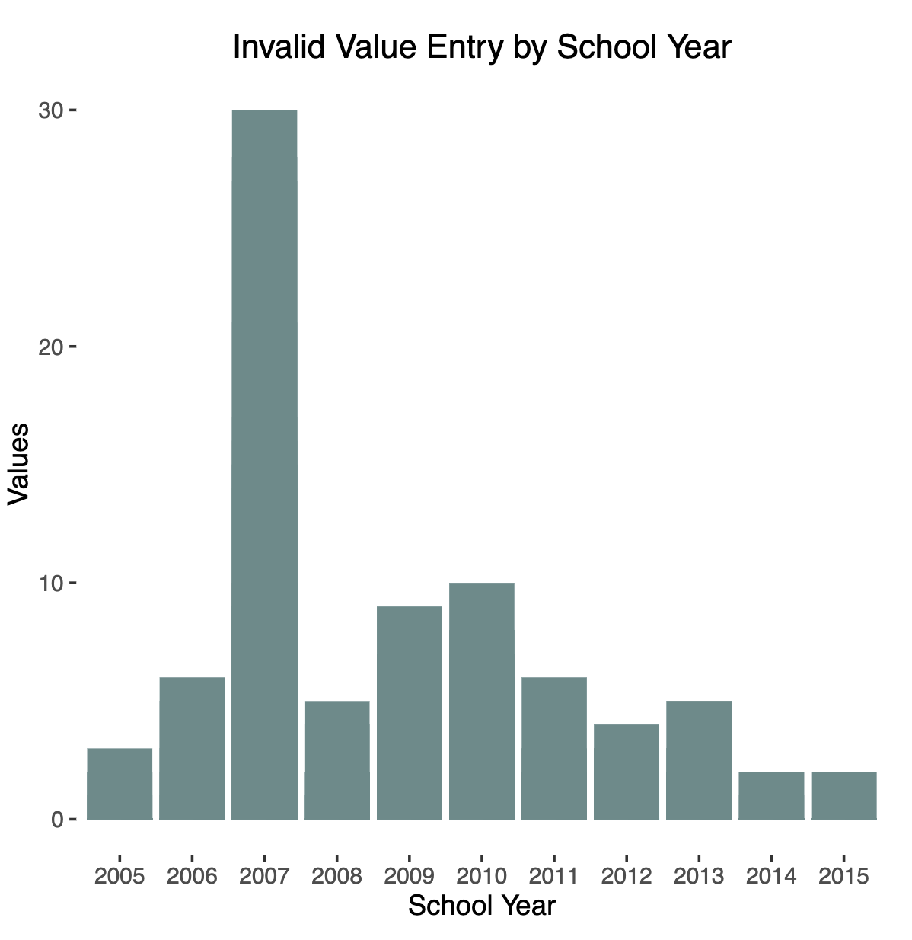
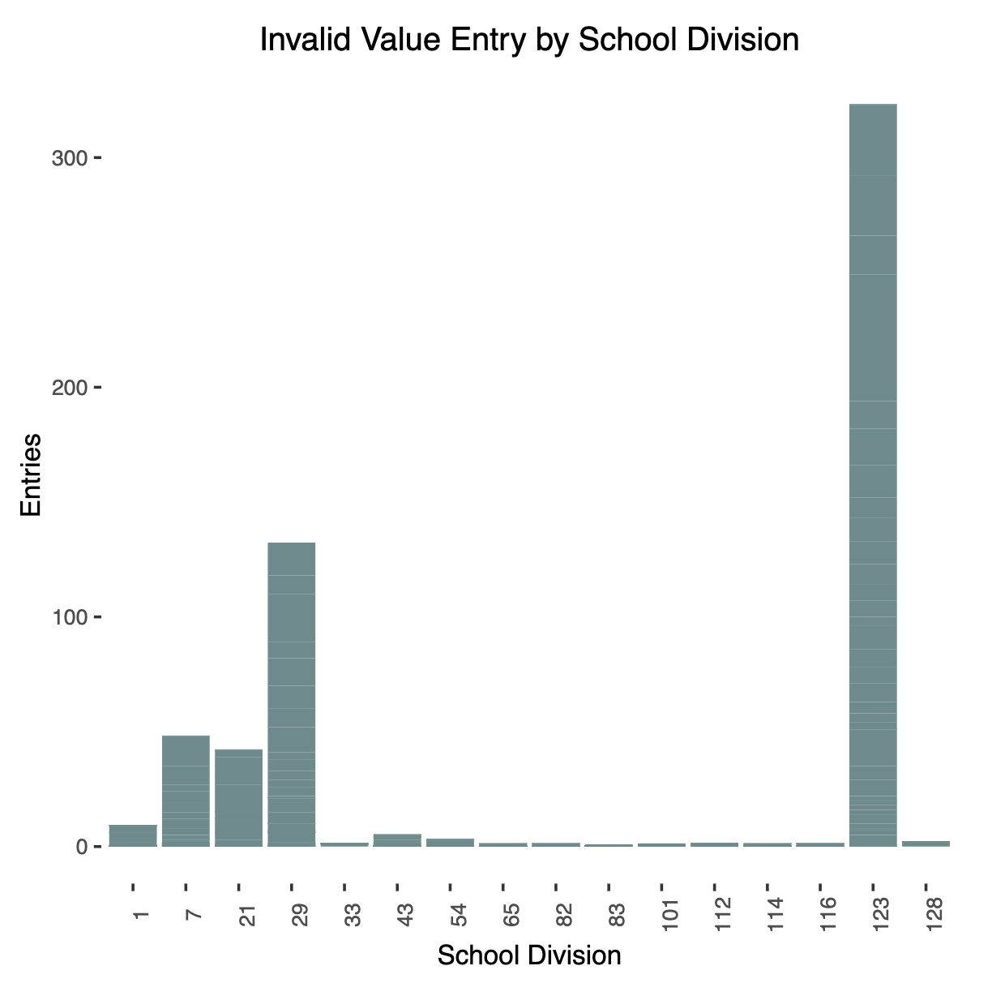
Data Profiling: Issues of Quality - “Value” Validity
When possible, very helpful to determine ‘when’ and ‘where’ errors have been made.
Notes:
When possible, it can be very helpful to determine ‘when’ and ‘where’ errors have been made.
Many times, errors are specific to a place and time and, therefore, can be controlled for.
Also, sharing these results with a data provider helps them locate and correct errors. And also support a lasting relationship with that data provider.

Slide 17
Data Profiling: Issues of Quality - Record Consistency
a measure of the degree to which two or more data attributes satisfy a well-defined dependency constraint – relationship validation
A simple consistency check might be:
a location disagreement like a zip-code that does not agree with a state code
a male who is also pregnant
A slightly more complicated example might be:
A student categorized as ‘Inactive’ or ‘Not enrolled’ but not having an entry for withdrawal date
Notes:
The concept of record consistency is best understood as the degree of logical agreement “between” record field/column values in either a single dataset or between two or more datasets.
When there is an expected logical relationship between two or more entities, we can refer to the rule specifying this logic as a type of relationship validation called a dependency constraint. Therefore, consistency becomes the degree to which these attributes satisfy said dependency constraint.
An example of a logical requirement is that fields A and B must sum to field C.
Logical requirements may be quite involved. For example, ‘A has two children’, ‘A is B’s father’, ‘A is C’s father’, and ‘A is D’s father’ are inconsistent.
A simple example of a dependency constraint violation would be a location disagreement like a zip-code that does not agree with a state code. Another might be the identification of a male who is also pregnant.
A more complex example would involve consistency validation of fields associated with student withdrawal in education records. For example, most education records contain some form of an ‘active code’ categorizing the student’s current form of interaction with the educational system. Most systems will have a code for ‘Inactive’ and/or ‘Not enrolled’. Most systems will also have afield for withdrawal date. If a student has been categorized as ‘Inactive’ or ‘Not enrolled’ but does not have an entry for withdrawal date, then there exists a consistency issue.

Slide 18
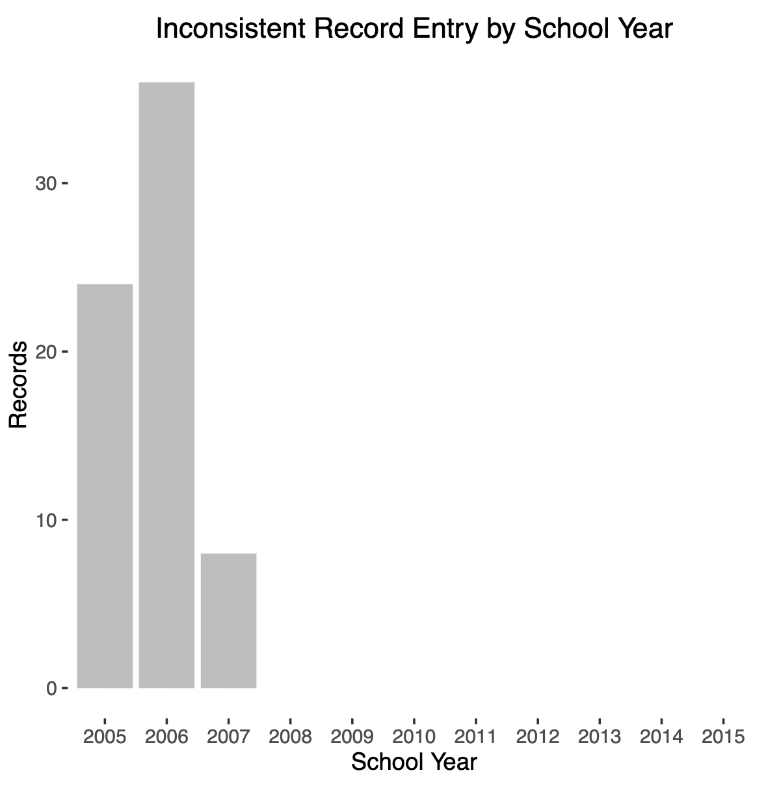
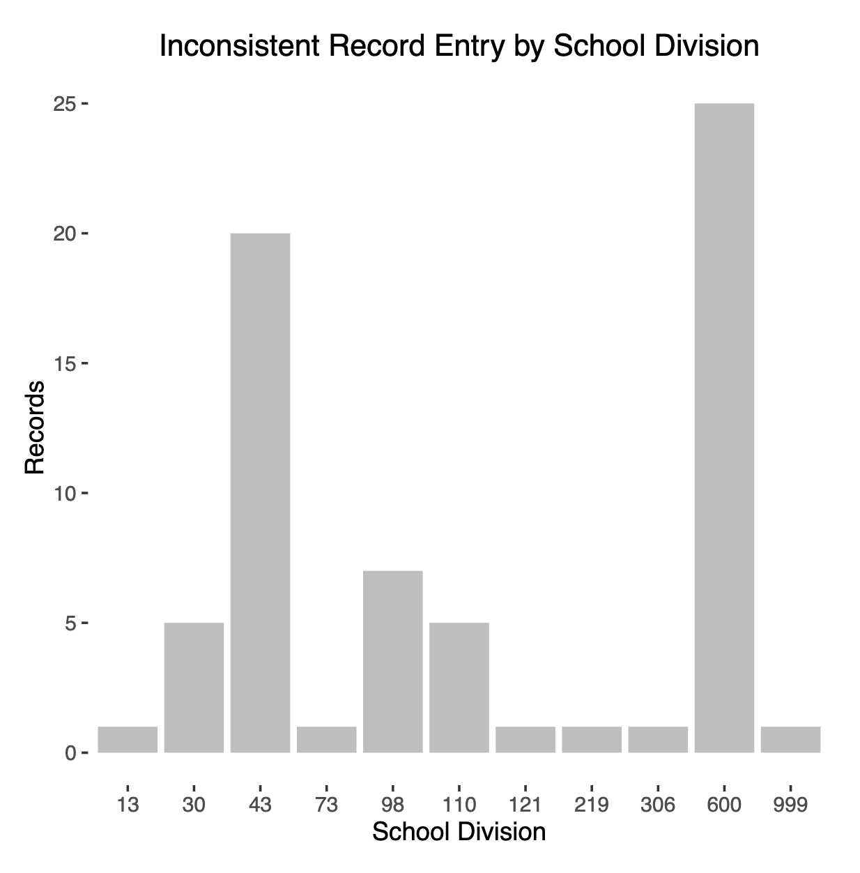
Data Profiling: Issues of Quality - Record Consistency
A record is inconsistent when active status is ”I”, but there is no exit code and exit date.

Slide 19
Data Profiling: Issues of Quality - Longitudinal Consistency
An inconsistency in the data when checked over time (longitudinally)
to see if the same value is recorded for every new record when it should be (i.e. birthdate and other demographics)
Some pseudocode might be:
count students from student records joined to itself on ‘student_id’ where ‘gender’ does not match
Demographics
Time

Slide 20
Data Profiling: Issues of Quality - Longitudinal Consistency
An inconsistency in the data when checked over time (longitudinally)
to see if the same value is recorded for every new record when it should be (i.e. birthdate and other demographics)
Example: In Virginia Education Records from 2005-2015, 16,300 children were found to have multiple genders.
Master Lists in Administrative Records are Incredibly RARE!
Consider:
Education Records – Multiple Recordings per Year
Social Service Records – Multiple Representations Across Multiple Systems!
Notes:
Causes of inconsistency are varied, but a common source of inconsistency comes from situations where locally derived information is provided with no associated master list or file. An exhaustive ‘master list’ of individuals receiving a public service are, in fact, quite rare. In my study, this occurred with student records such as from the Virginia Department of Education (VDOE). Here the student demographics occur in multiple records about the same student recorded in the same year. Truth must be derived from the multiple observations. For example, the VDOE data we found 16,310 of the 2,346,058 individuals to have more than one value for gender.
Social Service Records, at the local level, however, have to be the best example.
Multiple programs from multiple levels of government using multiple systems.

Slide 21
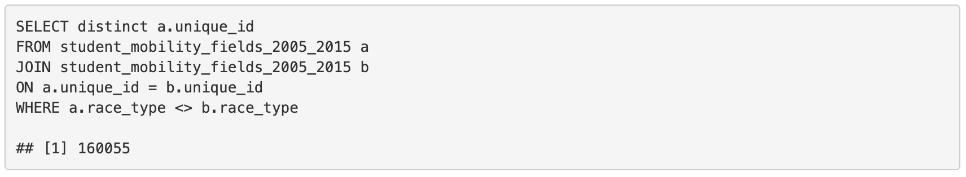
Data Profiling: Issues of Quality - Longitudinal Consistency
A consistently troublesome demographic variable, from a longitudinal consistency viewpoint, is race.
Sometimes people will periodically elect to change the racial category with which the identify.
Race categorization schemes change fairly frequently (in comparison to other demographic categories). Why do you think that is?
A longitudinal consistency check of race in the Virginia Student Record Collection:
- About 7% inconsistent
Notes:
A consistently troublesome demographic variable, from a longitudinal consistency viewpoint, is race.
Sometimes people will periodically elect to change the racial category with which the identify.
Race categorization schemes change fairly frequently (in comparison to other demographic categories). Why do you think that is?.

Slide 22
Data Profiling: Issues of Quality - Duplication
Duplication refers to the degree of replication of distinct observations per observation unit type
For example, in state-level secondary-education registration records, greater than 1 registration per student per official reporting period would represent duplication.
However, it is important to remember that while duplication can occur as a result of the accidental entering of the same information multiple times, duplication can occur many times as a direct result of the choice of level of aggregation; for example, aggregating to a single student registration per academic year when registration information is actually collected multiple times per academic year.

Slide 23
Data Profiling: Issues of Quality - Uniqueness
The concept of data uniqueness can be generalized as the number of unique valid values that have been entered in a record field, or as a combination of record field values within a dataset
Uniqueness is not generally discussed in terms of data quality, but for the purposes of answering research questions, the variety and richness of the data is of paramount importance.
Most notably, if a record field has very little value uniqueness (e.g. entries in the field ‘State’ for an analysis of housing within a county, which of course would be within a single state), then its utility would be quite low and can be conceptualized as having low quality in terms of the research question at hand.

Slide 24
Data Profiling: Issues of Metadata and Provenance
Metadata
Provenance
Observation Unit Definition
Datasets (tables) without definition and/or non-meaningful/confusing naming
Observation Unit Attributes Definition
Attributes (columns) without definition and/or non-meaningful/confusing naming
Semantic Confusion
Attributes with the same name but different definitions
e.g. An attribute named “Grade” can refer to both a 'score' for a test or the 'level/year’
Multiple Attribute Names
Attributes with different names but the same definition
e.g. Attributes name “Grade” and “Year” both referring to 'level/year' of schooling
Inconsistent Attribute Formats
Attributes of the same type that are formatted differently
e.g. Most commonly an issue when dealing with dates and times
System of Origin
Where was this data originally collected?
Data Process History
Attributes collected at different locations, with different tools
Intermediate Storage Systems
Chain of Custody
Contact Information
Who can I contact with my questions?
Transformation
What happened to the data since collection and why?
Notes:
Metadata is generally defined ”data that provides information about other data”. [http:www.merriam-webster.comdictionarymetadata]. The main purpose of metadata is the facilitation of the discovery relevant information pertaining to a particular object/resource. It does this by ”allowing resources to be found by relevant criteria, identifying resources, bringing similar resources together, distinguishing dissimilar resources, and giving location information.”[National Information Standards Or-27
ganization; Rebecca Guenther; Jaqueline Radebaugh (2004). Understanding Metadata. Bethesda,MD: NISO Press. ISBN 1-880124-62-9. Retrieved 2 April 2014.]
Therefore, generally speaking, a lack of metadata for a dataset can present significant impediments to the use of said dataset. Being more specific, when dealing with data that is to be used for research purposes, it is of vital importance to discover if the datasets (tables), their observational observation units (records/rows), and their attributes (fields/columns) are consistently named, sufficiently described, and appropriately formatted for analysis and for combination with other project datasets.
Additionally, does information exist regrading any transformations that have occurred to original data sources in the creation of said dataset, as well as who did the transforming?
Observation Unit Definition
When a dataset is provided without definition of the purpose of that dataset, we have an issue with the Observation Unit Definition. Why was this data collected? When dealing with datasets not originally collected for research purposes (e.g. administrative data), there is often no easy answer to this question. To correct issues of observational unit definition, it is often necessary to first generate separate new datasets from the dataset provided, each representing only a single observational unit type. At this point a new observational unit definition can be created.
This type of metadata is issue is quite common, and we experienced said issue when dealing with certain 3rd-party produced housing datasets. A single dataset would include, within each record(row), multiple potential observational units (e.g. housing unit data, listing service data, owner data, neighborhood data). Only after defining the observational units needed and extracting the necessary fields could a new observational unit definition be generated (e.g. Housing Unit Specifications for Arlington County VA from CY 20XX to CY 20XX).
The concept of Provenance is very broad and has different meanings within different fields of inquiry. For the purposes of Data Profiling, we find it useful to apply the definition provided by the World Wide Web Consortium (W3C) “Provenance of a resource is a record that describes entities and processes involved in producing and delivering or otherwise influencing that resource. Provenance provides a critical foundation for assessing authenticity, enabling trust, and allowing reproducibility. Provenance assertions are a form of contextual metadata and can themselves become important records with their own provenance. ”https://www.w3.org/2005/Incubator/prov/wiki/WhatIsProvenance
The provenance of designed data collections (i.e. surveys) is generally, almost by definition, available. The purpose and methods of collection are usually documented as part of a study design, as well as any transformations that had to be applied during the creation of the analysis dataset from the collection instrument.
For administrative data, however, provenence is generally NOT readily available. Personal contact with data management personnel is critically necessary to understand the methods of collection and any transformations that occur. We are seeing this right now in the Charlottesville EMS project.
Also, personal contact with policy-level personnel is equally needed to discern the original purpose of collection. Also, other researchers to help glean quality.

Slide 25
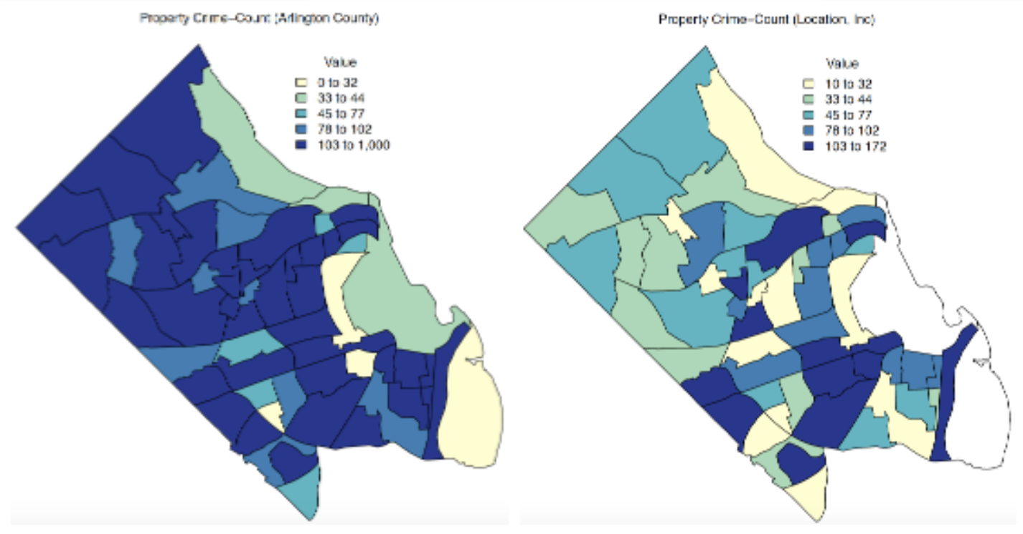
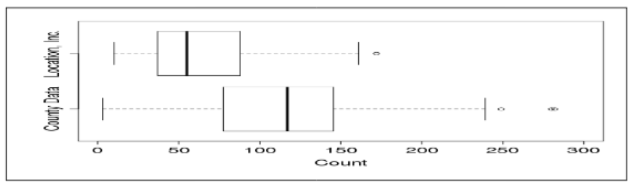
Data Profiling: Issues of Metadata and Provenance
Unknown Transformations!
Misalignment in data sources between proprietary and public “raw” data
The commercial provider would not describe, nor make available, their methods to adjust the counts
Notes:
Property Crime Example
Another example from our studies was from a commercial dataprovider which provided indicators of neighborhood quality based on patented algorithms. We were unable to reconcile differences found in their crime indexes and data from Arlington County, Virginia Police Incident Tracking system. This figure presents the misalignment in these data sources by census tract. The figure shows property crime counts as calculated by the commercial provider and as directly pulled from the Arlington County Police Incident Tracking system. The county data had five census tracts with counts greater than 300. These were not shown in the boxplot to allow a better scaled comparison to the commercial provider. The commercial provider did not describe, nor makes available, their methods to adjust the counts.

